Slide 1

The SEND Thresholds
Meeting with Emmaville Parents
1st October 2024

Slide 2
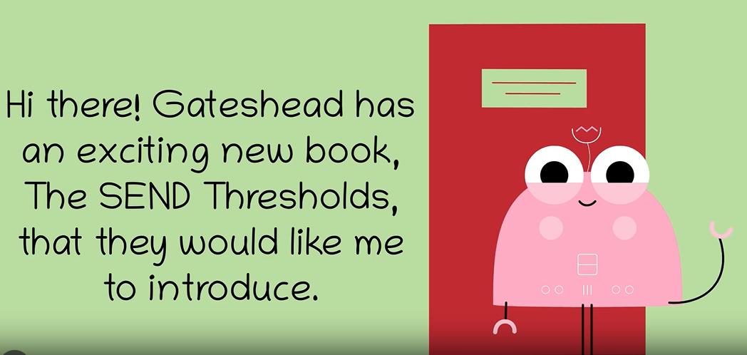

Slide 3
Key terms:
The ‘four areas of need’:
      Cognition and Learning
      Communication and Interaction (covering Social Communication & Speech, Language, Communication Needs)
      Social, Emotional and Mental Health (SEMH)
      Sensory / Physical / Medical
‘Services’ – includes Education, Health (mental and physical), Social Care, Speech & Language, OT
‘Quality First Teaching’ (QFT) – good, everyday classroom teaching, in every lesson
‘Provision’ – what we offer a child, not the setting (eg ‘specialist provision’ vs setting)

Slide 4
What are the ‘Thresholds’?

Slide 5
Essentially, the Thresholds are a breakdown of the levels of need a child may experience. The Thresholds progress from 1 to a maximum of 7 – the higher the Threshold, the higher the level of need and, therefore, the higher the level of intervention required.
They are intended to enable people to make both an accurate identification of needs based on the presentation of the child and, crucially, an identification of appropriate types of provision.
They are NOT a tick list! They are a basis for collaboration between school, home and services to form an accurate and full picture of a child’s level of need. This is then used to identify appropriate and realistic support. Whenever appropriate, input from the young person is also highly important.
Notes:
Where it says ‘Ranges’, think ‘Threshold’!

Slide 6
Typically, the higher the Threshold, the greater the involvement of outside agencies. Guidance is provided in the document.
Threshold 4 is where an EHCP would be considered. At Threshold 4 and above, the level of curriculum modification and personalisation increases notably, and the chance of specialist provision being considered and required also increases.
Quality First Teaching (inclusive teaching for all pupils in a class) remains essential in providing a firm basis upon which to use the additional strategies identified at each ‘Threshold’. Strategies and advice from earlier ‘Thresholds’ need to be continued alongside new ideas and approaches from higher Thresholds – they don’t stop (especially QFT)!
Notes:
Where it says ‘Ranges’, think ‘Threshold’!

Slide 7
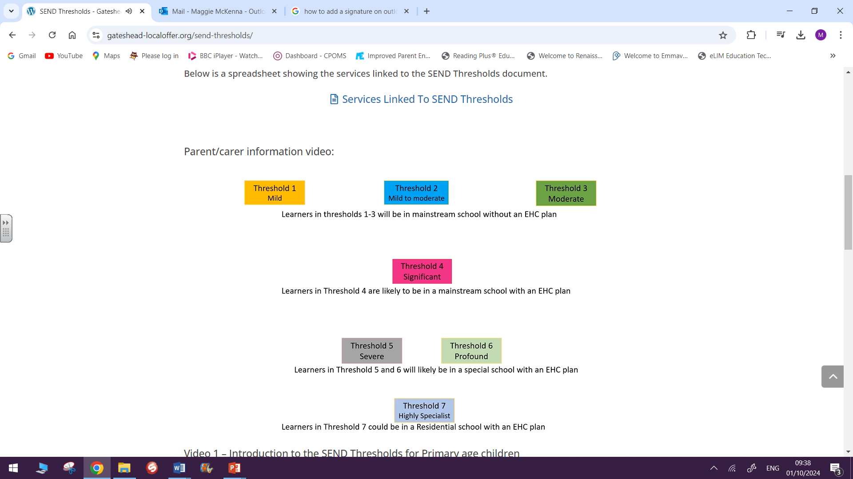

Slide 8
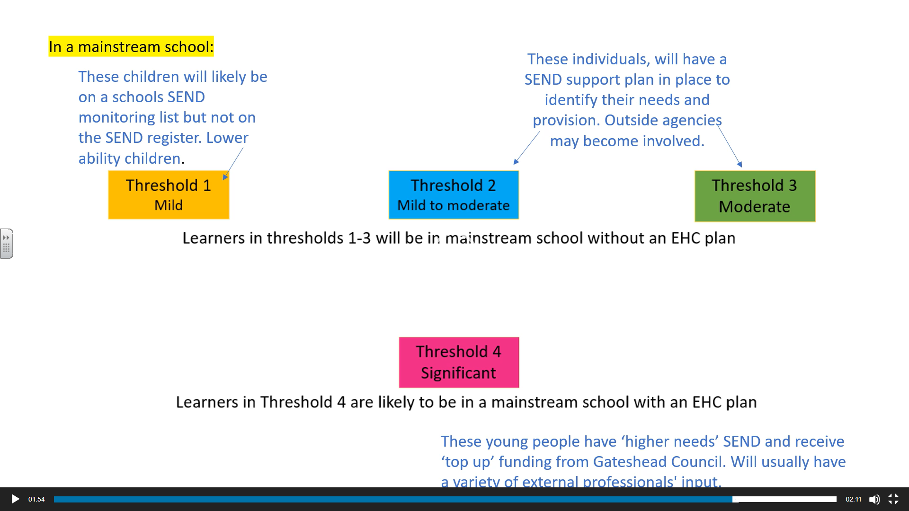

Slide 9
Why use a Thresholds approach?

Slide 10
Key aims and benefits…
Improved understanding of a given child’s needs, by breaking down possible presentations across the four areas of needs
Improved understanding of what sort of provision might be appropriate based on presenting behaviours and needs
Consistency of judgement and provision across all services
Full and ongoing involvement of the young person and their family/carers in the identification and provision of support. Parent and child voice is paramount – parents know their children best.
Improved transitions between academic phases, 0 to 25!

Slide 11
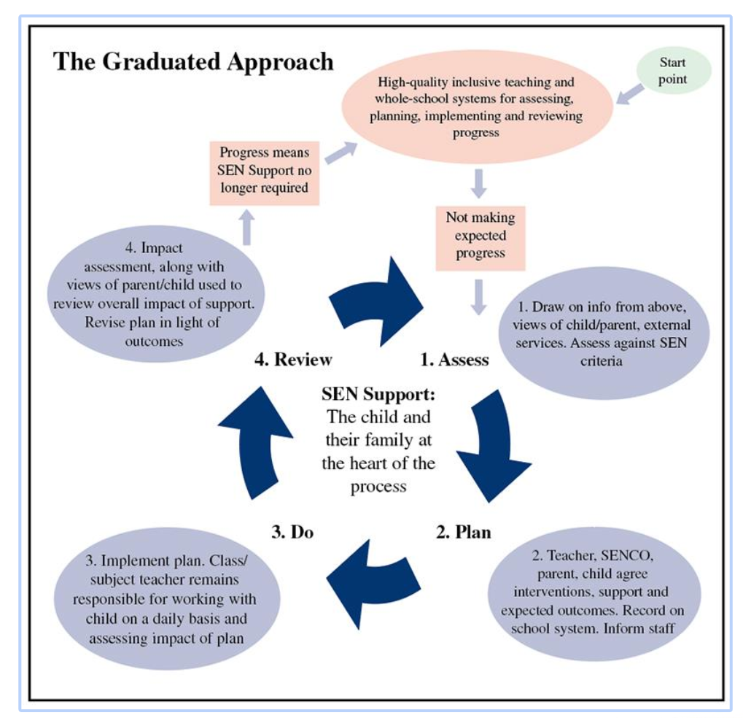
Supports and enhances the Graduated Approach to supporting SEND
This is our normal Support Plan practice at Emmaville which we do termly,

Slide 12
How they work…

Slide 13
Four Areas of Need:
Cognition and Learning
Communication and Interaction – Social Communication & Speech, Language, Communication Needs (including ASC)
Social, Emotional and Mental Health (SEMH)
Physical / Medical

Slide 14
How we identify a level of need …
1. Teachers to discuss needs of the child with SENDCo and talk to parents
Identify ‘Primary Area of Need’
Go to Overview, then identified Threshold, then Preparation for Adulthood (PfA)
Ask…What are we doing / could we be doing?
Repeat for other areas of need
What’s the ‘profile’?
Update Support Plan
Share support plan with parents and request their views and any additional relevant information.

Slide 15
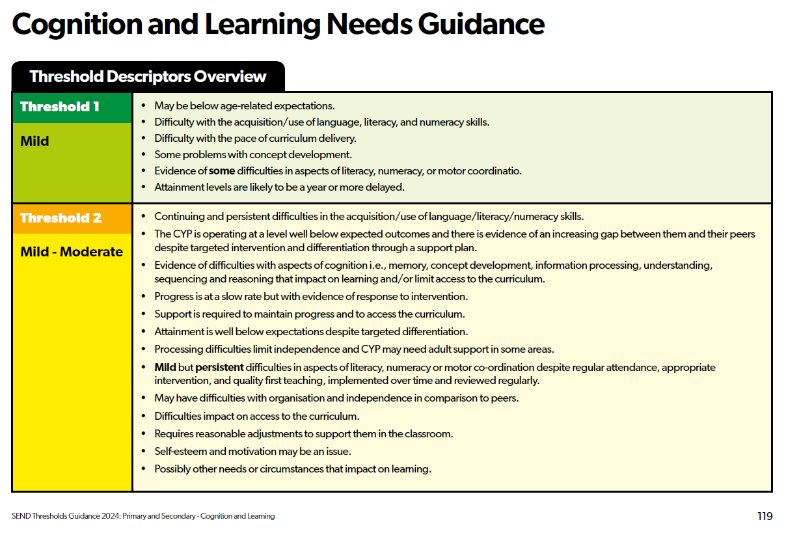

Slide 16
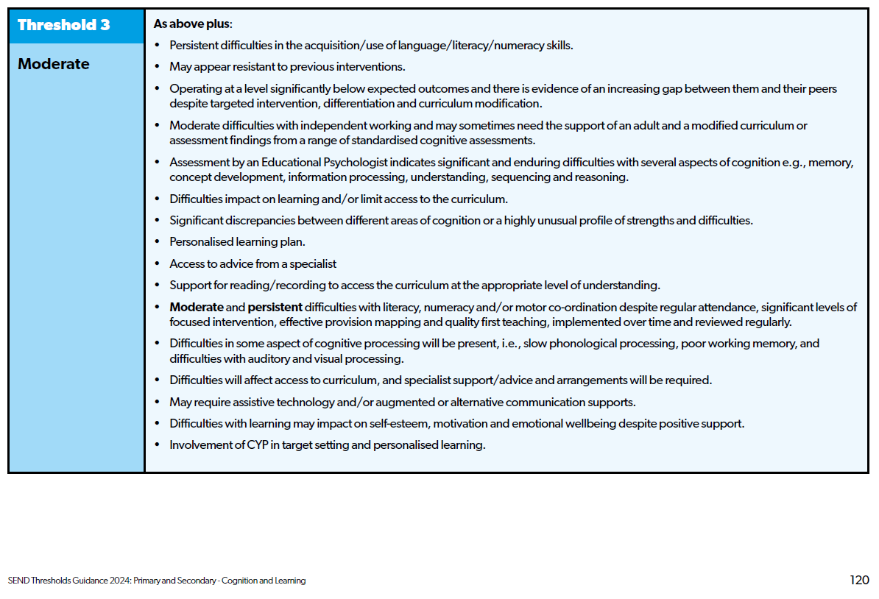

Slide 17
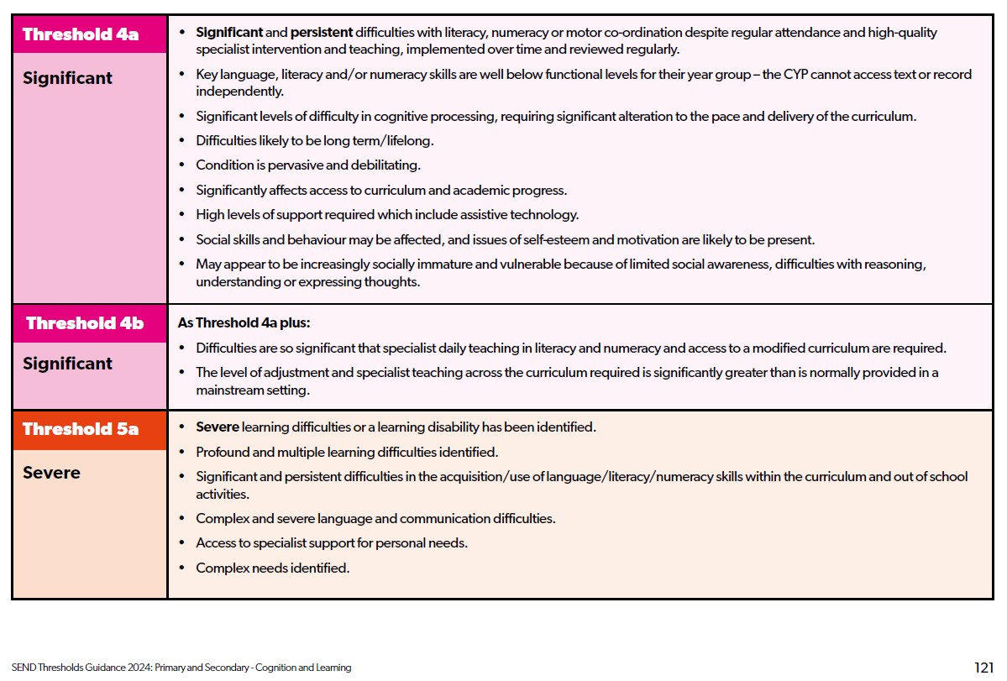

Slide 18
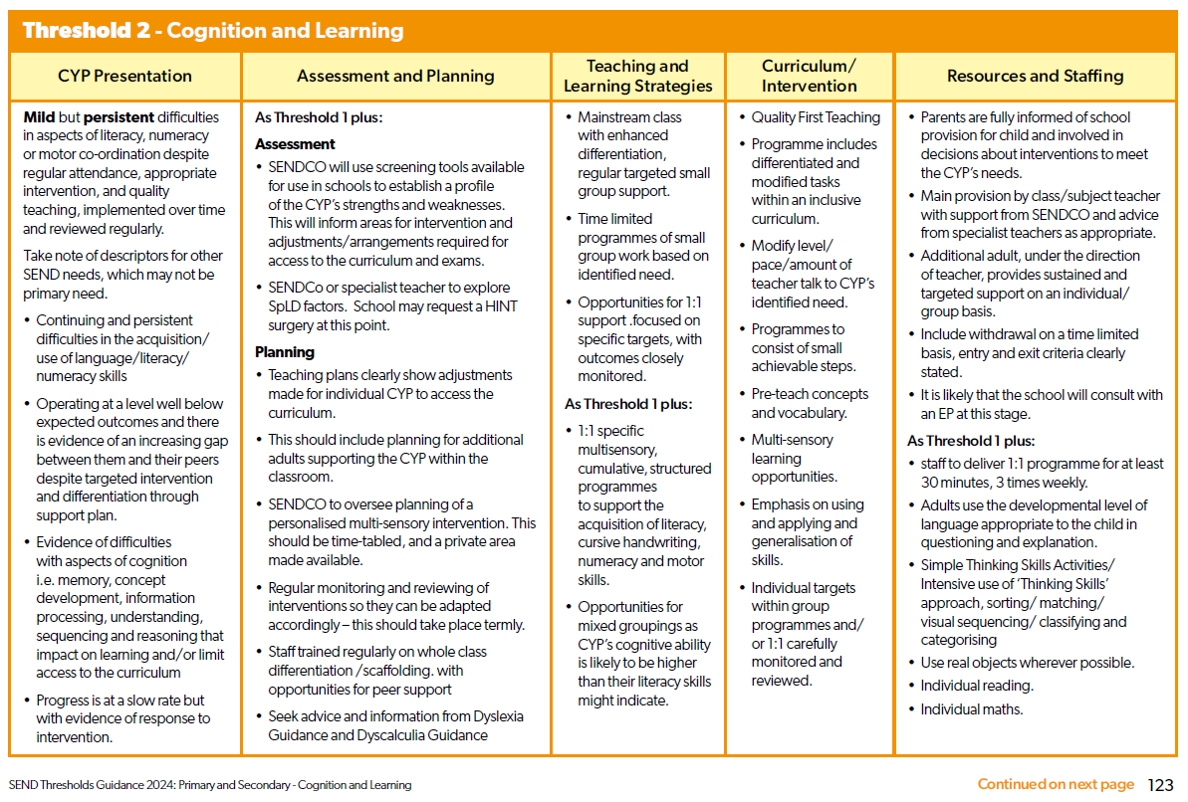
Page 116

Slide 19
After we have considered the child’s principle area of need, we now need to consider their needs in terms of PfA (Preparing for Adulthood)

Slide 20
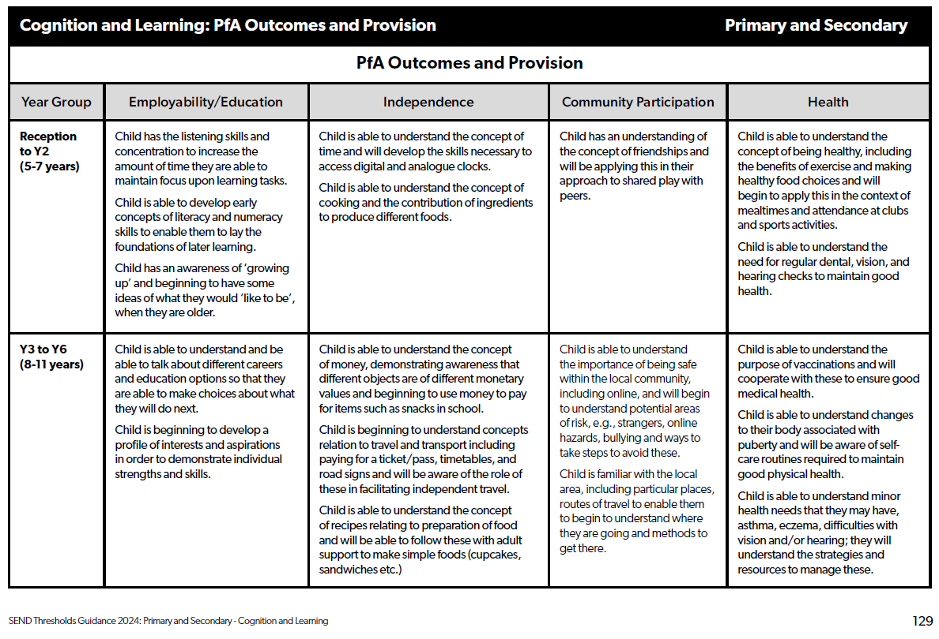

Slide 21
We would now check the other areas of need to enable us to get a holistic picture of your child.
This, alongside your views and your child’s views, will enable us to write a comprehensive support plan which will reflect your child’s needs and how they can be supported both at home and at school.
The support plans are reviewed termly and, if necessary, other professionals are consulted for additional assessment, advice and strategies to help us best support your child.

Slide 22
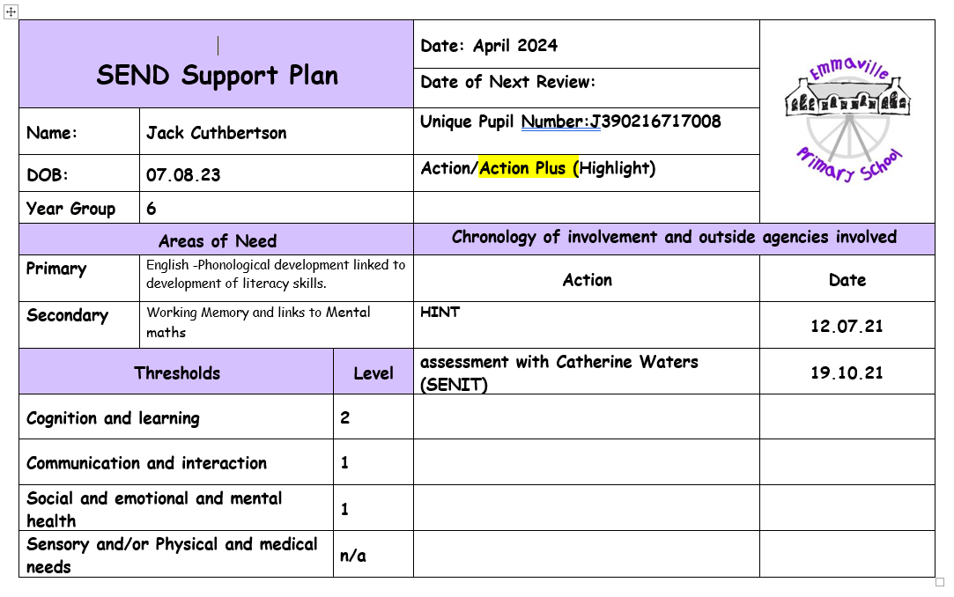

Slide 23
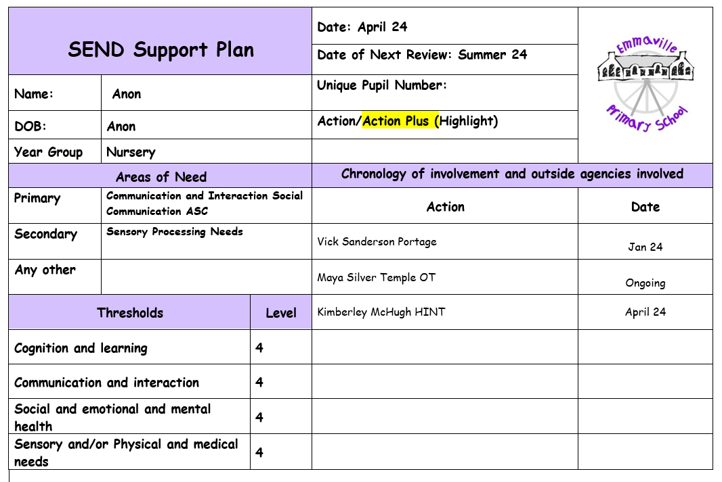

Slide 24
Early Years / 0-5…
Works in exactly the same way.
View it as a ‘0-5 years old’ document.
Could be used for children in KS1 if they are still working within EYs framework but alongside the ‘Primary and Secondary’ version.
Children with Speech and Language needs in Nursery / early Reception are not a major concern as this is often developmental – there’s not a lot mentioned in Thresholds 1 and 2
Communication and Interaction is not split as in Primary/Secondary doc
Notes:
Where it says ‘Ranges’, think ‘Threshold’!

Slide 25
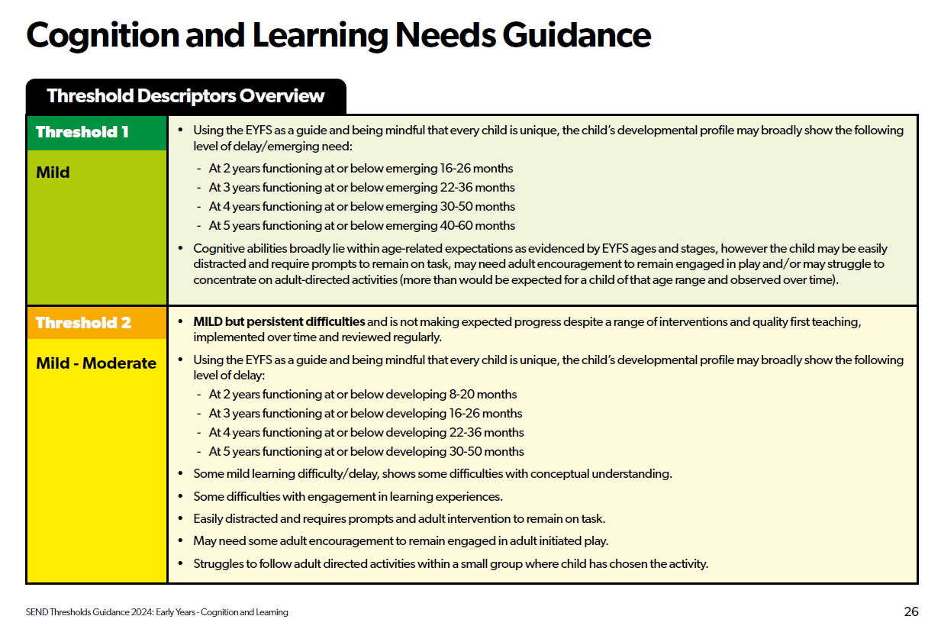
Page 53

Slide 26
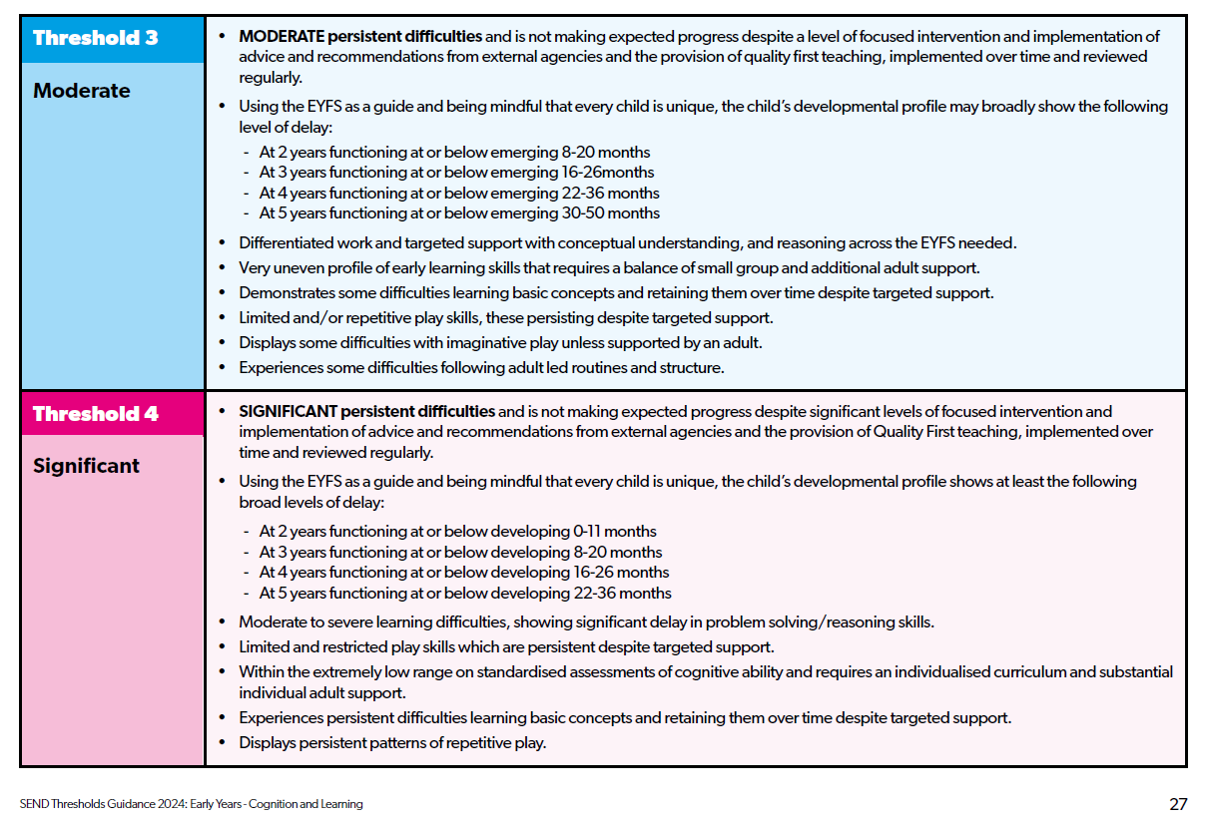
Page 53

Slide 27
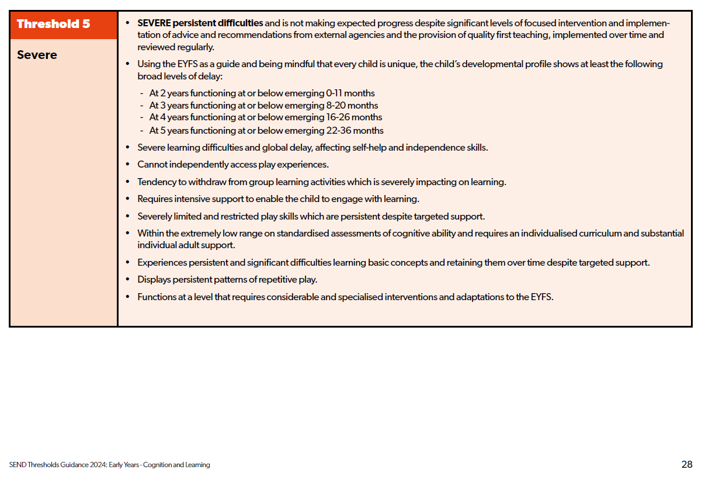
Page 53

Slide 28
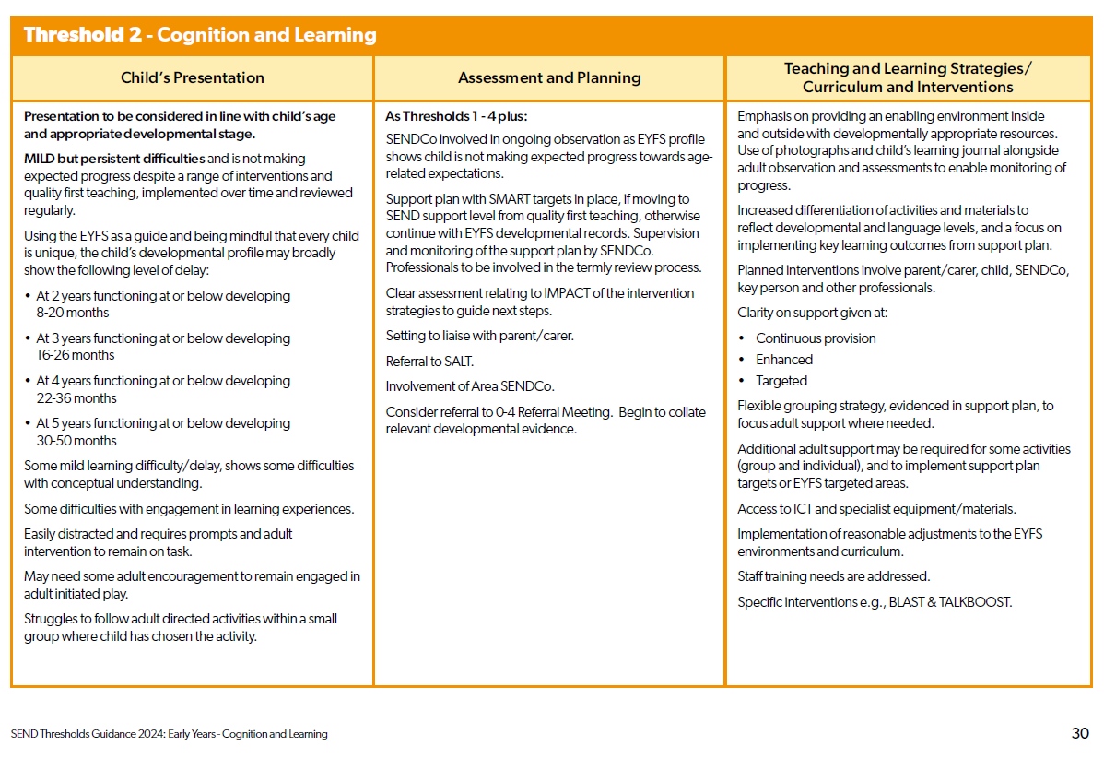
Page 53

Slide 29
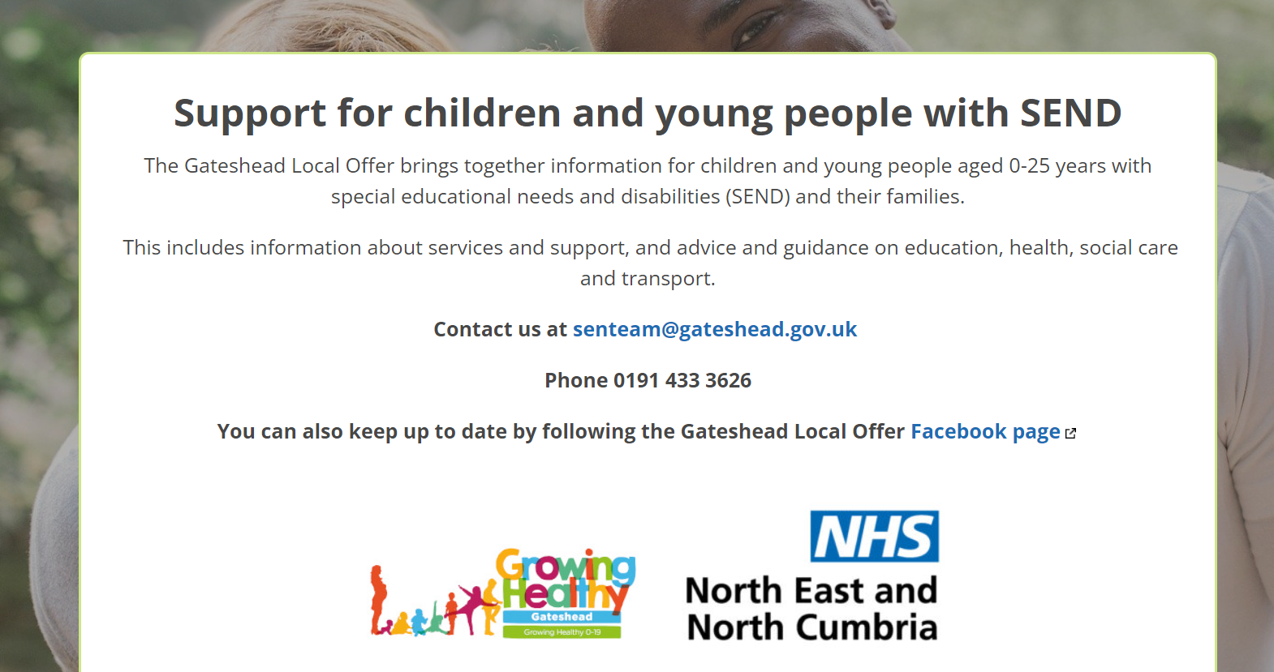
The full thresholds document can be accessed via the Gateshead Local offer
https://gateshead-localoffer.org/

Slide 30
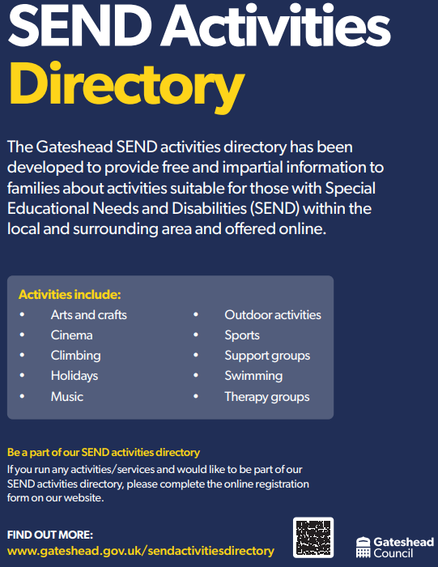
Further Support
Any additional information that school receive from the SEN team is added to the school newsletter.

